Slide 1

Blood Bank Management
Group 45

Slide 2
Introduction
The Blood Management System is an application through which any person who is interested in donating blood can register himself. Moreover, if any general consumer wants to make a request for blood online he can also take the help of this application.
The Blood Management System in java is planned to collect blood from many donors in short from various sources and distribute that blood to needy people who require blood.

Slide 3
Classes and their Relationships
Login
ForgotPassword
Signup
StaffDetails
DonorDetails
RecipientDetails
StockDetails
ContactUsInfo

Slide 4
Database Tables
Bloodbank
Donor
Receiver
Staff_transaction
user

Slide 5
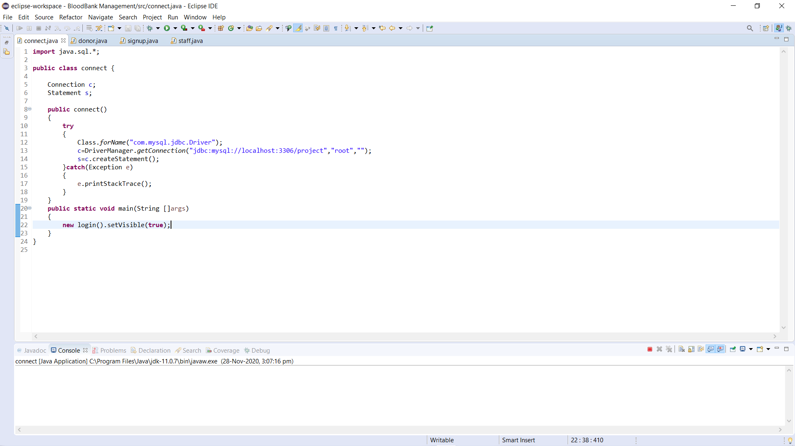
Snippet of JDBC(Connection class)
Exception Handling

Slide 6
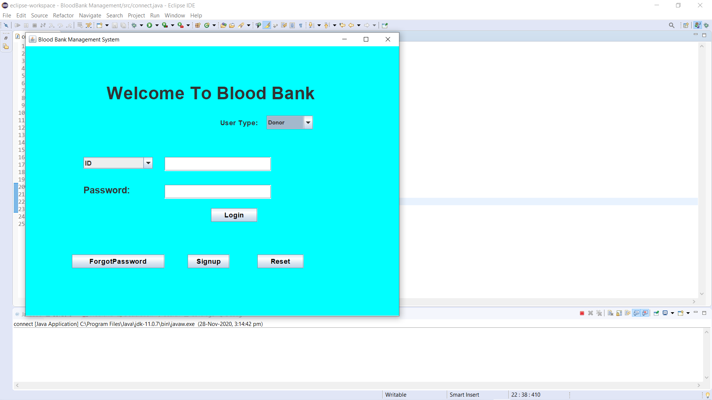
Login Screen

Slide 7
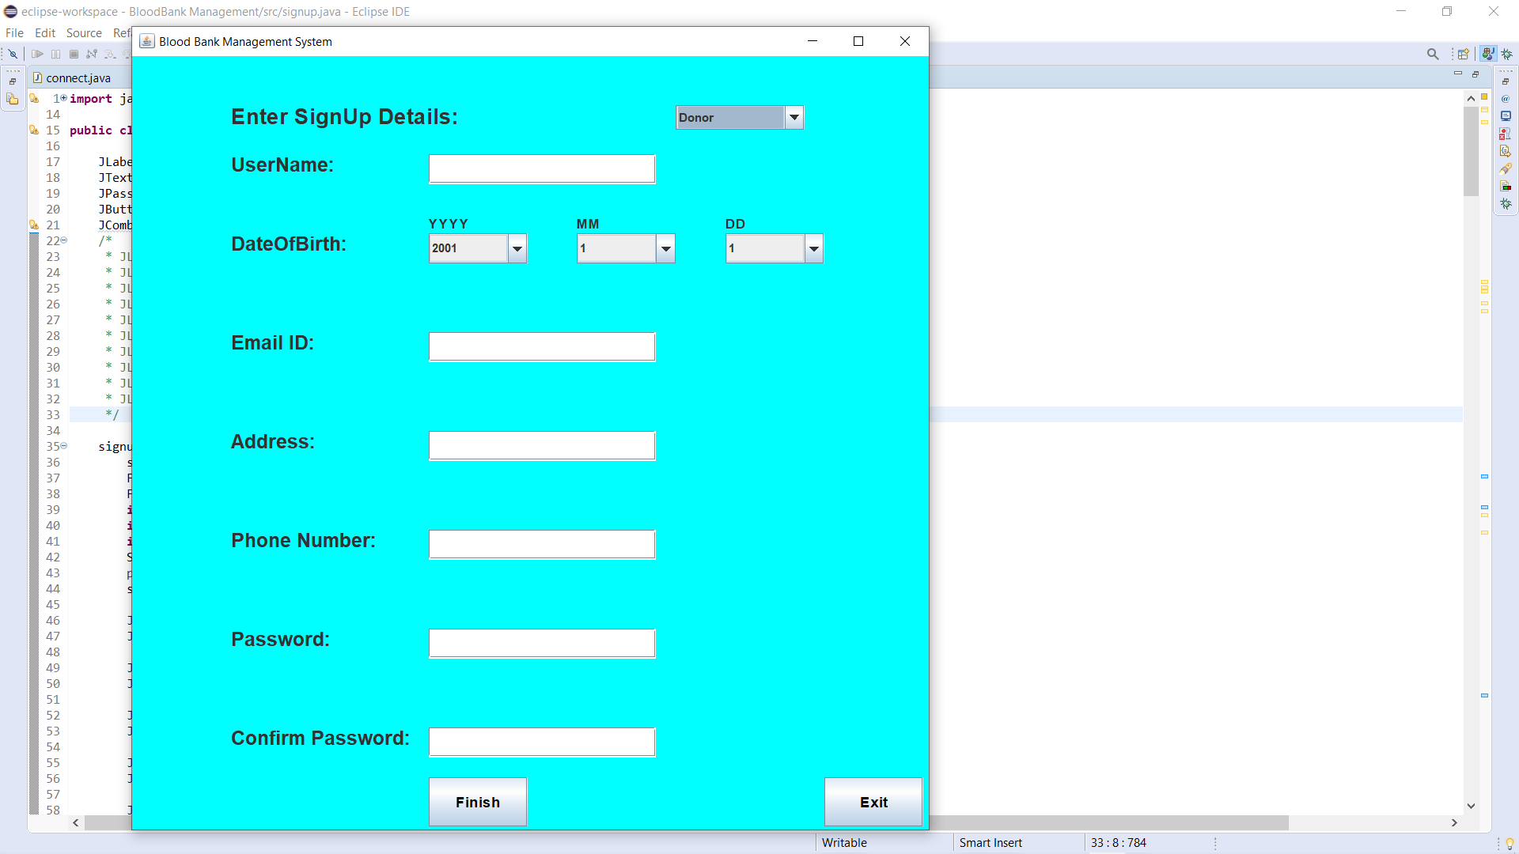
Signup Screen

Slide 8
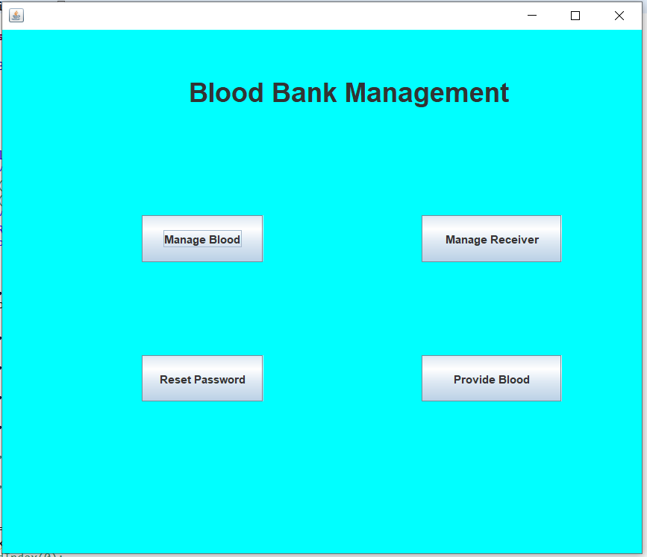
Home Screen

Slide 9
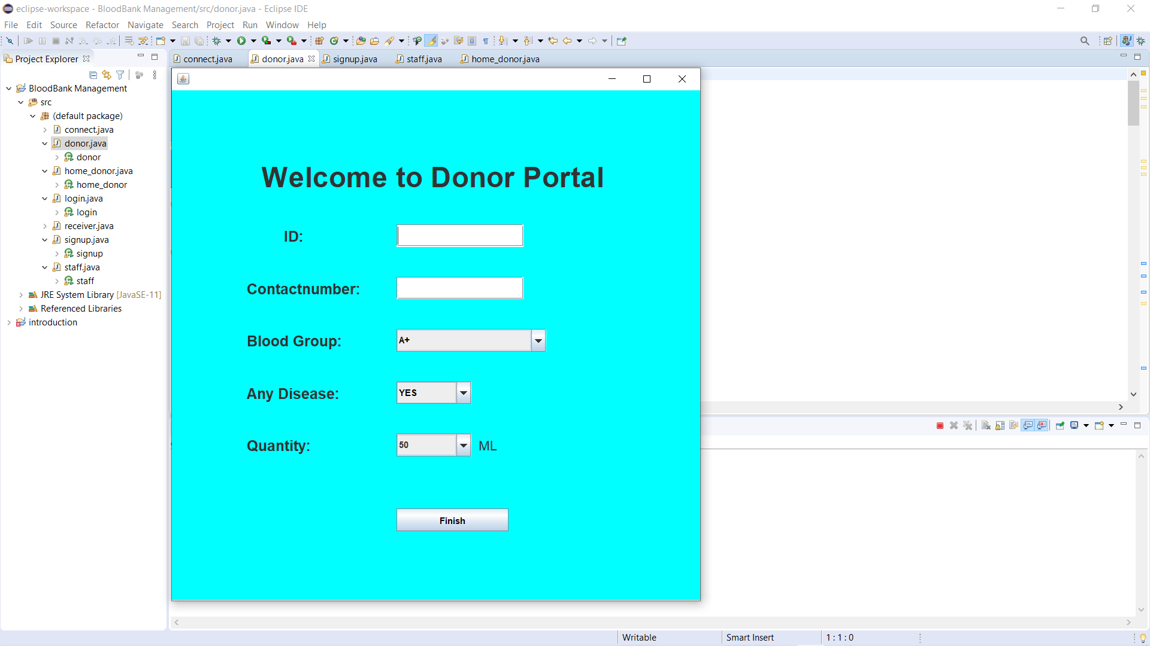

Slide 10
Thank you!

